Slide 1
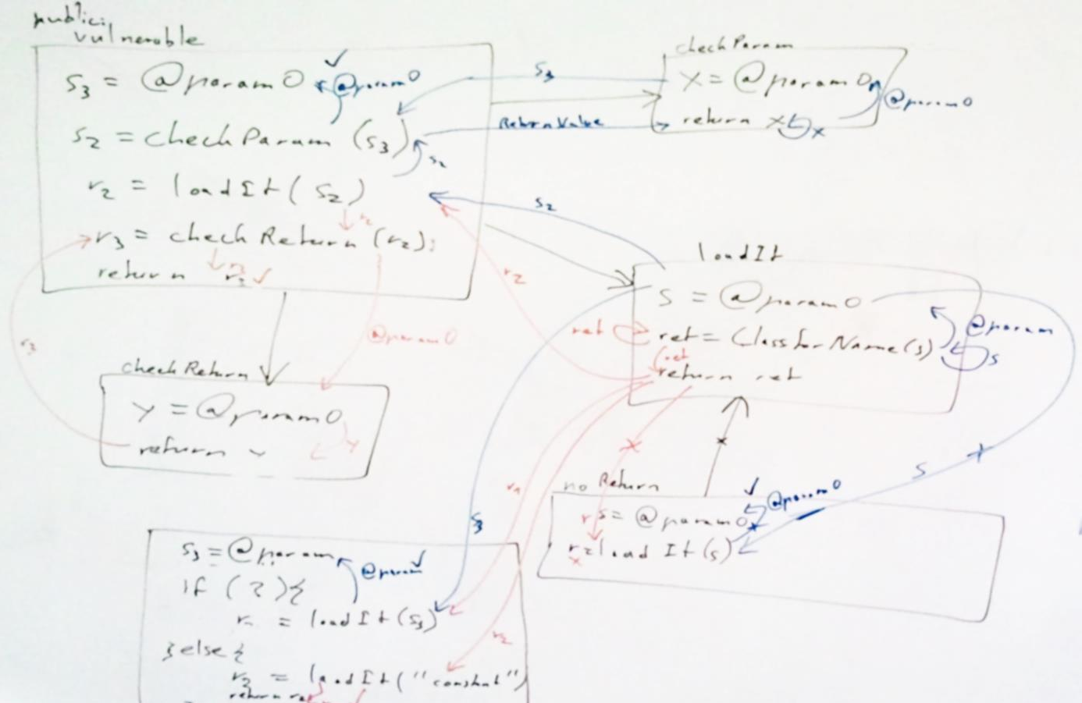
Design Your Analysis! A Case Study on Implementation Reusability of Data-Flow Functions
Johannes Lerch and Ben Hermann
{lastname}@cs.tu-darmstadt.de
@stg_darmstadt

Slide 2
Concerns of Analyses
Native Code
Cast Expressions
Exceptions
(Un-)boxing of Types
Return Values
Assignments
Reflection
Method Invocation
Static Fields
Type Conversion
Library Code
Sanitization
Instance Fields
Method Arguments
Taint Sinks
Collections
Taint Sources
Callbacks
Arrays

Slide 3
Analysis Frameworks
Examples: Soot, WALA, OPAL
Intermediate Representations
Abstractions over Instructions
Algorithms/Frameworks
IFDS/IDE
Abstract Interpretation

Slide 4
IFDS/IDE Framework
public interface FlowFunctions<N, D, M> {
FlowFunction<D> getNormalFlowFunction(N curr, N succ);
FlowFunction<D> getCallFlowFunction(N callStmt,
M destinationMethod);
FlowFunction<D> getReturnFlowFunction(N callSite,
M calleeMethod, N exitStmt, N returnSite);
FlowFunction<D> getCallToReturnFlowFunction(N callSite,
N returnSite);
}
public interface FlowFunction<D> {
Set<D> computeTargets(D source);
}

Slide 5
Large Clients of the IFDS Framework
How to maintain this?
How to test this?
How to reuse this?
Notes:
We were at this stage as well.
The Software Engineer in ourselves was screaming, so we tried to improve our design.
We came up with a new interface

Slide 6
Propagator Interface
public interface Propagator<N, D, M> {
boolean canHandle(D fact);
KillGenInfo<D> propagateNormalFlow(D source, N curr,
N succ);
KillGenInfo<D> propagateCallFlow(D source, N callStmt,
M destinationMethod);
KillGenInfo<D> propagateReturnFlow(D source, N callSite,
M calleeMethod, N exitStmt, N returnSite);
KillGenInfo<D> propagateCallToReturnFlow(D source,
N callSite);
}
FlowFunction<D> getNormalFlowFunction(
N curr, N succ);
public interface FlowFunction<D> {
Set<D> computeTargets(D source);
}
Notes:
One implementation per concern. How this is possible will be discussed on the next slide.
First, let’s have a closer look at the interface.
1. Basically, we merged the two interfaces we had before.
We replaced the result by a pair of a boolean and a set making things more explicit than before. Boolean reflects if the source taint is killed, set reflects the generated facts.

Slide 7
Phase Processing
F
Phase
gen
F
Propagators
F
F
no kill
Phase
gen
F
Propagators
F
F
kill
Phase
Propagators
F
F
F

Slide 8
Implementation
Set<D> computeTargets(D source) {
boolean killed = false;
Set<D> gens = new HashSet<D>();
for(Propagator<D>[] phase : phases) {
for(Propagator<D> propagator : phase) {
if(propagator.canHandle(source)) {
KillGenInfo kgi = propagate*(source, ...);
killed |= kgi.kill;
gens.addAll(kgi.gens);
}
}
if(killed)
break;
}
return gens;
}
phases = new Propagator[][] {
{
new PrimitiveTypesKiller(),
new PermissionCheckPropagator(),
/* ... */
},
{
new AssignmentPropagator(),
new FieldAccessPropagator(),
new StringBuilderPropagator(),
/* ... */
},
{
new SinkHandler(),
/* ... */
}
};

Slide 9
Discussion
Separation of concerns
Easier to maintain
Easier to test
Easier to reuse
Case Study
Implemented SQL-Injection, Path Traversal, Unchecked Redirect, … vulnerability detection
Reused FlowTwists implementations, only source, sink, and sanitization specific Propagators implemented

