Slide 1
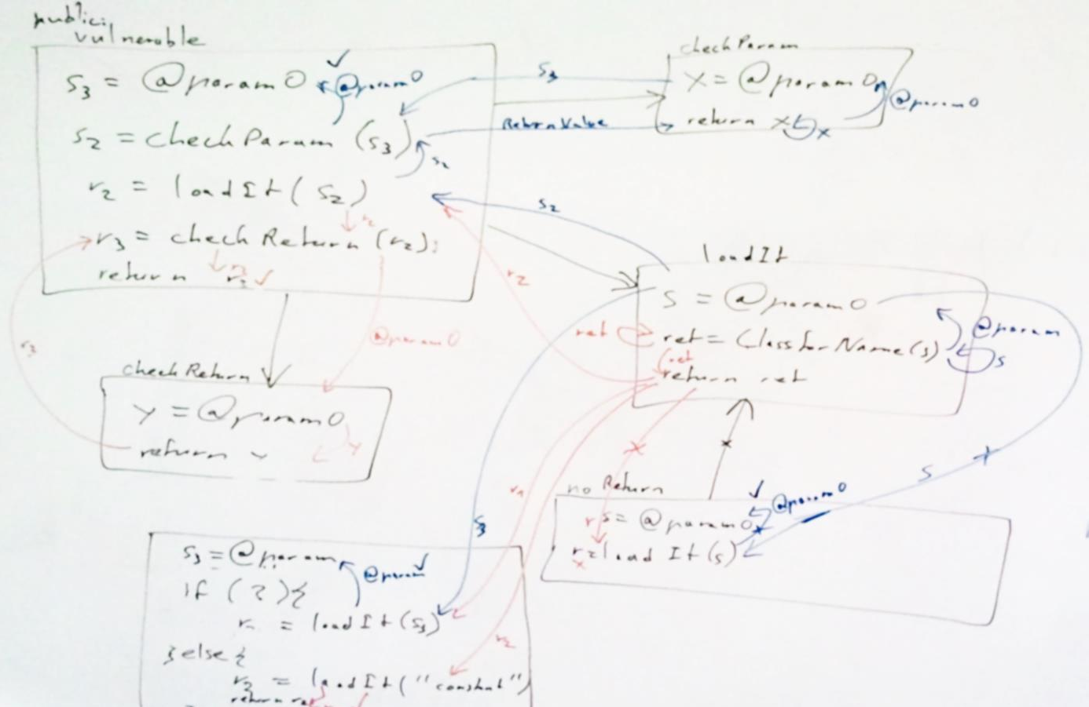



Access-Path Abstraction: Scaling Field-Sensitive Data-Flow Analysis With Unbounded Access Paths
Johannes Lerch, Johannes Späth, Eric Bodden, and Mira Mezini
https://github.com/Sable/heros
@stg_darmstadt

Slide 2
Scalable Field-Sensitive Taint Analysis
Based on IFDS-Framework [Reps et al. 1995]
    Context Sensitive
    Flow Sensitive
  Field Sensitive
  → Scalability Issues
  Contributions of this work:
    Identification of problematic cases
    Approach solving these: IFDS-APA
Notes:
1 taint analysis based on IFDS
2 field sensitive
3 scalability issues
4 contributions

Slide 3
Tracking Fields
A a1 = new A()
A a2 = new A()
x = source()
a1.f = x
y = a2.f
sink(y)
Field Sensitive
Field Based
x
x
x, a1.f
x, A.f
x, a1.f
x, y, A.f
False Warnings
Notes:
Assume taint analysis: from source to sink
1-4 field sensitive
5-7 field based
Preferable to be field sensitive

Slide 4
Loops
x = source()
do {
b = new A()
b.f = x
x = b
} while(…)
x
x
x.f, b.f
x, b.f
x.f, b.f.f
x.f, b.f
x.f.f, b.f.f
x.f, b.f,
x.f.f, b.f.f,
Notes:
Fixpoint Iteration
Finite Domain required!

Slide 5
K-limiting
k-limiting [Jones et al. 1981]:
a.f.f.....f.f
→
a.f.f.....f.*
x = source()
do {
b = new A()
b.f = x
x = b
} while(…)
k
k
x
x
x.f, b.f
x, b.f
x.f, b.f.f
x.f, b.f
x.f.f, b.f.f
x.f, b.f,
x.f.f, b.f.f,

Slide 6
K-limiting
k-limiting [Jones et al. 1981]:
a.f.f.....f.f
→
a.f.f.....f.*
x = source()
do {
b = new A()
b.f = x
x = b
} while(…)
k
k
x
x
x.f, b.f
x.f.*, b.f.*
x, b.f
x.f, b.f.*
x.f.*, b.f.*
x.f, b.f
x.f.*, b.f.*
x.f.*, b.f.*
x.f, b.f,
x.f.*, b.f.*,
Large k → many facts
k-limiting with k = 1

Slide 7
Over-Approximation
foo() {
a.f = source()
b.a = a
c = b.a.g
bar(c)
}
bar(c) {
sink(c)
}
a.f
b.a.*
c.*
c.*
Small k → taints spread
k-limiting with k = 1
Notes:
Issue may occur for any k !
(e.g. loop on previous slide)

Slide 8
State Explosion
a = source()
while(…) {
if(…)
a.f = a
else
a.g = a
}
a
a, a.f, a.g
a.f.f, a.f.g, a.g.f, a.g.g
a.f.f.f, a.f.f.g, a.f.g.f, …
yields different Access Paths for n fields and k-limiting
Amount of facts explodes
Notes:
For n=10 and k=3 generates over 1000 facts

Slide 9
State Explosion
<<interface>>
Foo
X bar(X)
calls
calls
FooA
FooB
…
X bar(X)
X bar(X)
writes field a
writes field b

Slide 10
Summaries
foo() {
a.f = source()
b = id(a)
sink(b)
}
bar() {
a.g = source()
b = id(a)
sink(b)
}
a.f
p.f
id(A p) {
return p
}
p.f
p.g
p.g
a.g
Summaries not reusable

Slide 11
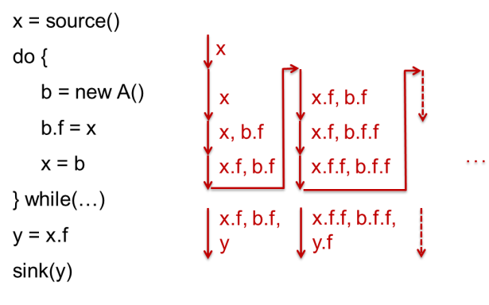
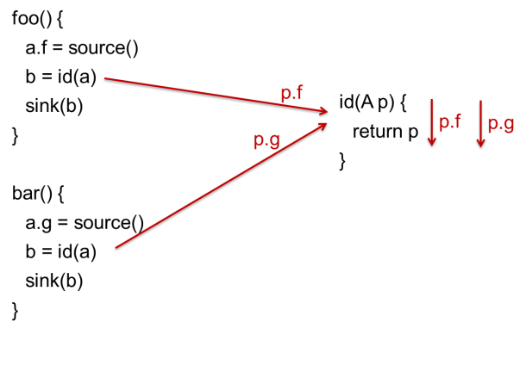
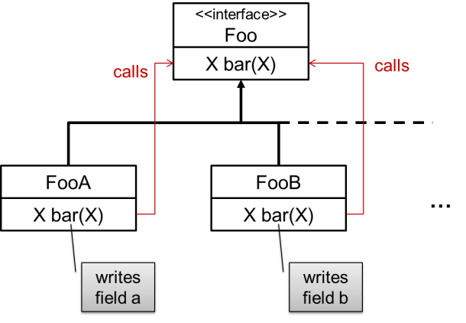
Identified Problems
Finite Domain
Reusability of Summaries
State Explosion
Notes:
K-limiting has several issues -> maybe not the right solution: general problem: finite domain
Start by addressing summaries

Slide 12
Abstract Summaries
foo() {
a.f = source()
b = id(a)
sink(b)
}
bar() {
a.g = source()
b = id(a)
sink(b)
}
p.f
id(A p) {
return p
}
p
p.g
p
.g
Notes:
Idea/Solution fails if fields are read or written

Slide 13
Field Read
a.g
a
a.f
bar(a) {
b = a.f
return b
}
a
a.f
b

Slide 14
Field Read – Transitive Check
0
x
foo(x) {
...
bar(y)
}
x
x.f
x.g
y
y.f
a
a
a.f
bar(a) {
b = a.f
return b
}
a
b

Slide 15
Field Write
a.f
a
a^f
bar(a) {
a.f = null
return a
}
a
a.g
a^f
a^f short for a.*\{f}

Slide 16
Field Write – Transitive Check
0
x
foo(x) {
...
bar(y)
}
x
x^f
x.f
y
y^f
a
a
a^f
bar(a) {
a.f = null
return a
}
a
a^f
a^f short for a.*\{f}

Slide 17
Identified Problems
Finite Domain
Reusability of Summaries
State Explosion

Slide 18
Abstraction Points
SP:
foo(a) {
while(…) {
b = new A()
b.x = a
a = b
}
c = a.x
d = c.x
a<SP>
L1:
a<L1>
a<L1>
b.x<L1>
a.x<L1>
c<L1>
d<x:L1>
Notes:
We abstracted at method start points
-> generalize to arbitrary abstraction points (loop entries, return edges)
Solves finite domain

Slide 19
Identified Problems
Finite Domain
Reusability of Summaries
State Explosion
Notes:
Solves state explosion as well
Abstracts away written fields

Slide 20
Evaluation
SecuriBench
    Benchmark consisting of 7 web applications
      Including all their dependencies
      especially the Java Class Library
    Taint analysis for SQL injection, command injection, path traversal, unchecked redirection

Slide 21
Evaluation – SecuriBench Including Dependencies
Project | IFDS-APA | K-limiting |  |  |  | Field Based
 |  | k=3 | k=2 | k=1 | k=0
blueblog | 1.21 | OoM | 54.56 | 43.54 | 27.15 | 1.05
jboard | 322.70 | OoM | OoM | OoM | 228.84 | 40.81
pebble | 108.38 | OoM | OoM | OoM | 138.40 | 17.13
personalblog | 202.08 | OoM | OoM | OoM | 236.65 | 24.92
roller | 478.81 | OoM | OoM | OoM | 102.83 | 35.19
snipsnap | 307.65 | OoM | OoM | OoM | 203.16 | 113.01
webgoat | 57.75 | OoM | 253.56 | 98.14 | 30.86 | 6.70
Run Time in Seconds

Slide 22
Visited Interprocedural Control-Flow Graph Edges
Application
Libraries
Method
Call Edge

Slide 23
Evaluation – SecuriBench Including Dependencies
Project | ICFG Edges | IFDS-APA | K-limiting |  |  |  | Field Based
 |  |  | k=3 | k=2 | k=1 | k=0
blueblog | 692 483 | 3% | OoM | 29% | 29% | 46% | 8%
jboard | 2 353 761 | 14% | OoM | OoM | OoM | 61% | 30%
pebble | 1 769 459 | 13% | OoM | OoM | OoM | 62% | 27%
personalblog | 2 194 345 | 15% | OoM | OoM | OoM | 62% | 28%
roller | 2 891 553 | 15% | OoM | OoM | OoM | 56% | 27%
snipsnap | 2 683 739 | 14% | OoM | OoM | OoM | 63% | 28%
webgoat | 734 345 | 16% | OoM | 44% | 41% | 52% | 20%
Visited Interprocedural Control-Flow Graph Edges

Slide 24
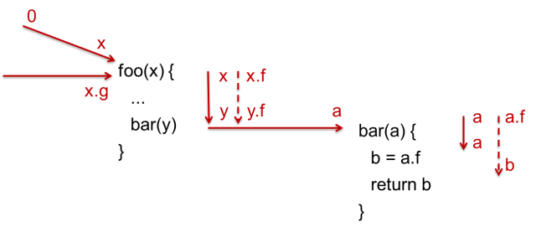
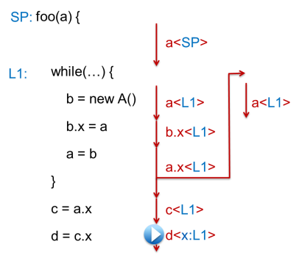
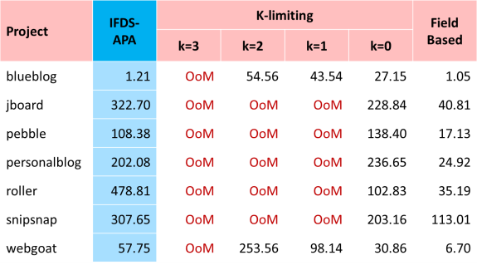
Summary
Finite Domain
Reusability of Summaries
State Explosion
Caller Dependent
Paused Edges
Abstraction Points
Scales as well
as Field Based
Take away: More precise does not automatically mean more expensive

