Slide 1
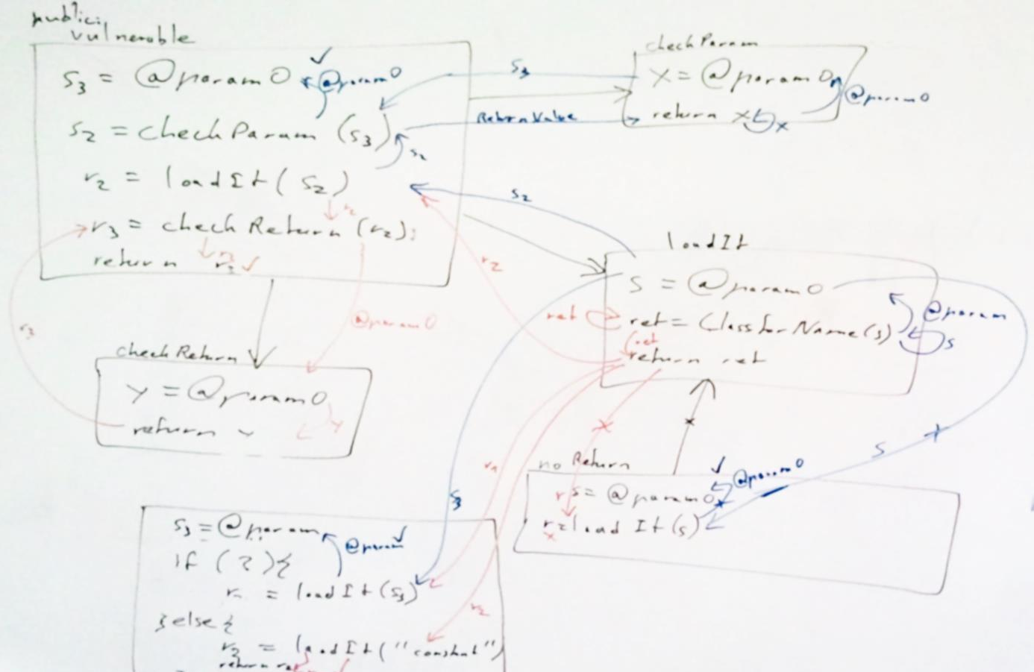
FlowTwist: Efficient Context-Sensitive Inside-Out Taint Analysis for Large Codebases
Johannes Lerch, Ben Hermann, Eric Bodden, and Mira Mezini
{lastname}@cs.tu-darmstadt.de
https://github.com/johanneslerch/FlowTwist
@stg_darmstadt

Slide 2
Oracle pushed out new Java update to patch security holes
Released Friday, the latest critical patch update contains fixes for 50 different security flaws.
Feb 04, 2013
Java flaw draws Web attacks, reports say
A vulnerability in the Java software has the potential to affect a wide swath of computer users, and researchers warn that it‘s already being exploited “in the wild”.
Jan 10, 2013
New vulnerabilities found in latest Java update
Following ist latest updates, more vulnerabilities have been uncovered in Oracle‘s Java 7 runtime.
Aug 31, 2012
Oracle patches Java 7 vulnerability
Breaking its quarterly update schedule, Oracle has released a new Java runtime that addresses recent security flaws.
Aug 30, 2012
Oracle issues emergency Java update to patch vulnerabilities
After hackers attack a new flaw in Java, “Oracle decided to release a fix for this vulnerability and another closely related bug as soon as possible”.
Mar 04, 2013
Oracle releases software update to fix Java vulnerability
Emergency software update repairs vulnerability that could allow remote attackers to execute arbitrary code.
Jan 13, 2013
New Java flaw could hit 1 billion users
A new Java vulnerability has surfaces that apparently affects all Java runtimes and therefore puts close to a billion users at risk.
Sep 26, 2012
Homeland Security still advises disabling Java, even after update
DHS says an unpatched vulnerability may still put Web browsers using the plugin at risk of remote attack.
Jan 14, 2013
Notes:
In August 2012 we could read about Java vulnerabilities
And the day after
and this kept going on
curious -> looked at vulnerability
to understand, first concepts of security model

Slide 3
Theory: Stack-based Access Control
SecurityManager.checkPermission | FilePermission, SocketPermission, ...
SecurityManager.checkWrite | FilePermission, SocketPermission, ...
FileOutputStream.<init> | FilePermission, SocketPermission, ...
Attacker.doEvil | Ø
MyApplet.init | Ø
∩ = Ø
Notes:
Scenario: writing a file
checkPermission call before writing
1) code has permissions
2) computes intersection
checks should be done like this

Slide 4
Theory: Stack-based Access Control
“
”
Reality:
public static Class<?> forName(String className) throws ClassNotFoundException {
return forName0(className,
true,
ClassLoader.getCallerClassLoader());
}
Implicit Permission Check
Class.forName | Privileged ClassLoader
Attacker.doEvil | Unprivileged ClassLoader
MyApplet.init | Unprivileged ClassLoader
Notes:
reality is different
Example: Class.forName
References to arbitrary classes
sun.misc.Unsafe: copyMemory
No permission check
1) implicit check through class loader
2) only immediate caller checked

Slide 5
Leak in sun.beans.finder.ClassFinder (CVE-2012-4681)
public static Class<?> findClass(String className)
{
try
{
ClassLoader cl = ...
...
return Class.forName(className, false, cl);
}
catch (ClassNotFoundException e)
{
}
catch (SecurityException e)
{
}
return Class.forName(className);
}
throws SecurityException
“handled” here
Notes:
Introduced in Java 7
Retrieves ClassLoader -> passes to Class.forName
1) Check successful -> SecurityException
2) „handled“
Class.forName called

Slide 6
Leak in sun.beans.finder.ClassFinder (CVE-2012-4681)
public static Class<?> findClass(String className)
{
try
{
ClassLoader cl = ...
...
return Class.forName(className, false, cl);
}
catch (ClassNotFoundException e)
{
}
catch (SecurityException e)
{
}
return Class.forName(className);
}
Class.forName | Privileged ClassLoader
ClassFinder.findClass | Privileged ClassLoader
Attacker.doEvil | Unprivileged ClassLoader
MyApplet.init | Unprivileged ClassLoader
throws SecurityException
“handled” here
Notes:
ClassFinder is checked

Slide 7
Deriving the Static Program Analysis Problem
Caller Sensitive
Track the return value
Private Method
Class.forName | Privileged ClassLoader
ClassFinder.findClass | Privileged ClassLoader
Attacker.doEvil | Unprivileged ClassLoader
MyApplet.init | Unprivileged ClassLoader
Private Method
Track the parameter
Public Method
Notes:
1 ignore attacker code
2 ignore (un-)privileged
3 any public method to caller sensitive
4 private methods
5 track parameter
6 track return value
-> taint analysis problem

Slide 8
Two Independent Analyses
Source
Sink
Caller Sensitive
Track the return value
Private Method
Private Method
Track the parameter
Public Method
Sink
Source
Notes:
Paramter
1) Return value

Slide 9
Two Independent Analyses: Not Context-Sensitive
Caller Sensitive
Track the return value
Private Method
Private Method
Private Method
Track the parameter
Public Method
Public Method
Notes:
May result in false warnings
Two analyses: not context-sensitive

Slide 10
Pure Forward Context-Sensitive Approach
Caller Sensitive
Private Method
Private Method
Private Method
Public Method
Public Method
Source
Sink
Notes:
Pure forward
Source & sink public method
1) Track return
2) Dont report

Slide 11
Results – only Class.forName
Notes:
Only Class.forName
Executions with different max heap
works

Slide 12
Results – all Caller Sensitive Methods
Did not Terminate
Notes:
All caller sensitive methods
1) Did not terminate

Slide 13
Scale of the Problem
Caller Sensitive
Private Method
Private Method
Private Method
Public Method
Public Method
Public Method
~45,000 methods
Notes:
Understand the scale of the problem
Can we reduce something?
1) More public methods (one)
2) 45k more

Slide 14
Scale of the Problem
64 methods
Private Method
Caller Sensitive
Private Method
3,656 call sites
Private Method
Private Method
Private Method
Private Method
Private Method
Private Method
Public Method
Public Method
Public Method
~45,000 methods
Notes:
Called methods have to be analyzed
1) 64 caller sensitives; 3,500 call sites -> low chance to hit
-> Idea: exploit this imbalance

Slide 15
Exploit Imbalance to Improve Scalability
64 methods
Private Method
Caller Sensitive
Private Method
3,656 call sites
Private Method
Private Method
Private Method
Private Method
Private Method
Private Method
Reverse Analysis
Public Method
Public Method
Public Method
~45,000 methods
Notes:
Back to two analyses
Higher hit chance for return value
Not for parameter
1) reverse problem
2) not context-sensitive
3) Solve issue
-> match results based on IFDS algorithm
No path information

Slide 16
IFDS Algorithm [17,19] Reports Leaks
Caller Sensitive
?
Public Method
Notes:
Only outputs if there is a leak
Extend IFDS algorithm

Slide 17
IFDS Algorithm: Computing Summaries
foo(a) {
b = a
c = b
return c
}
a →{a}
1:
2:
3:
a →{a, b}
a →{a, b}
Notes:
computes summary edge for each method
1) initial edge to all start points
2) flow function
3) Concatenated edge

Slide 18
IFDS Algorithm: Computing Summaries
foo(a) {
b = a
c = b
return c
}
1:
2:
3:
a →{a, b}
a →{a}
b →{b, c}
a →{a, b, c}
Notes:
1) Concatenated edge

Slide 19
IFDS Algorithm: Computing Summaries
foo(a) {
b = a
c = b
return c
}
1:
2:
3:
a →{a, b, c}
Notes:
Final summary
Callers can immediately apply summary

Slide 20
Path Construction
foo(a) {
b = a
c = b
return c
}
pred(b) = a
stmt(b) = #1
1:
2:
3:
a →{a, b}
a →{a}
b →{b, c}
pred(c) = b stmt(c) = #2
a →{a, b, c}
Notes:
1) Store predecessor & stmt line 1 2) Store predecessor & stmt line 2 predecessor chain -> reconstruct path afterwards

Slide 21
Path Construction: Merge at Branches
bar(a) {
if (...) {
b = a
}
else {
b = a
}
return b
}
1:
2:
3:
pred(b₁) = a
stmt(b₁) = #1
a →{a, b₁}
a →{a, b₂}
pred(b₂) = a
stmt(b₂) = #2
a →{a, b₁, b₂}
Notes:
Complicated for branches
Different example
1) Summary edge & preds Decision at merge:
keep both
miss one branch
--> evaluation

Slide 22
Results – only Class.forName
Notes:
Faster
Less memory

Slide 23
Results – all Caller Sensitive Methods
Did not Terminate
Did not Terminate
Notes:
Did not terminate as well
But: IFDS algorithm terminated
Unable to enumerate all paths required to match results

Slide 24
Two Synchronized/Dependent Analyses
Private Method
Caller Sensitive
Private Method
Private Method
Private Method
Private Method
Private Method
Private Method
Private Method
Public Method
Public Method
Public Method
Notes:
Idea: synchronize analyses
-> reduce amount of paths 1) initial seeds
2) pause edge
3) continue edge
4) call
5) context-sensitive return no pause -> balanced / unbalanced

Slide 25
Two Synchronized/Dependent Analyses
Private Method
Caller Sensitive
Private Method
Private Method
Private Method
Private Method
Balanced Return
Private Method
Private Method
Private Method
Unbalanced Return
Public Method
Public Method
Public Method
Notes:
As extension to IFDS algorithm

Slide 26
Results – only Class.forName
Notes:
Slightly faster than before

Slide 27
Results – all Caller Sensitive Methods
Did not Terminate
Did not Terminate
Notes:
Terminates!

Slide 28
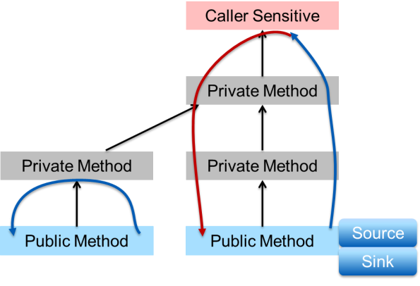
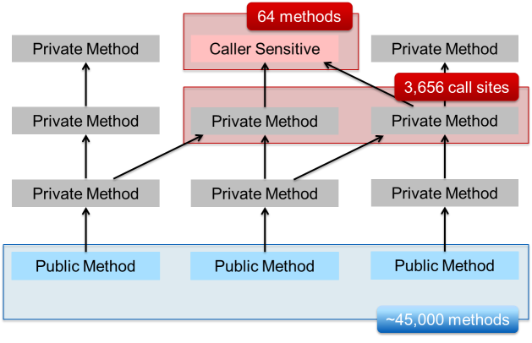
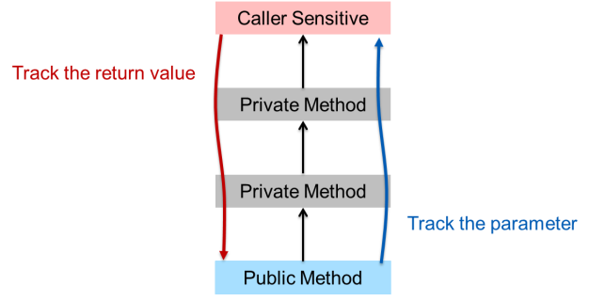
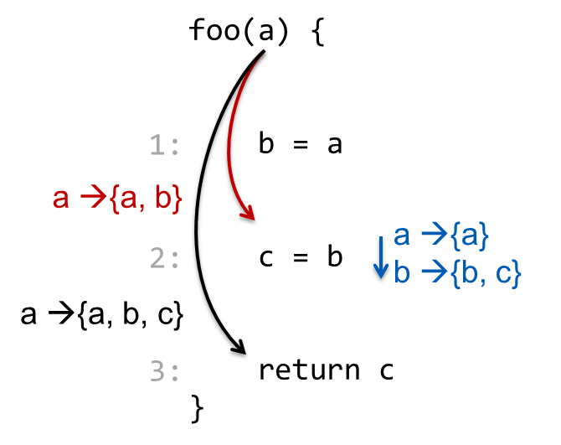
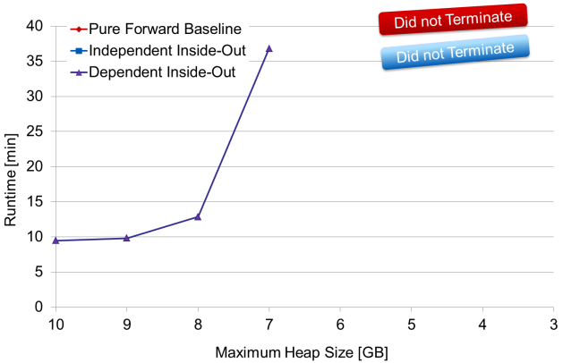
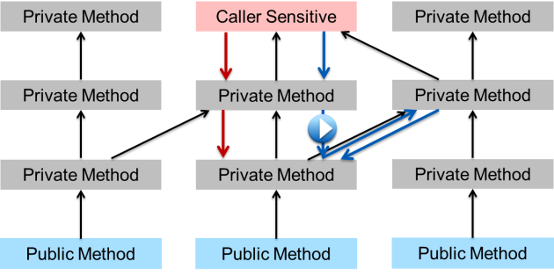
Summary
Notes:
1) Derived the analysis problem 2) Single analysis solution 3) two analyses may scale better 4) path construction for IFDS 5) synchronized analyses 6) evaluated

